Slide 1
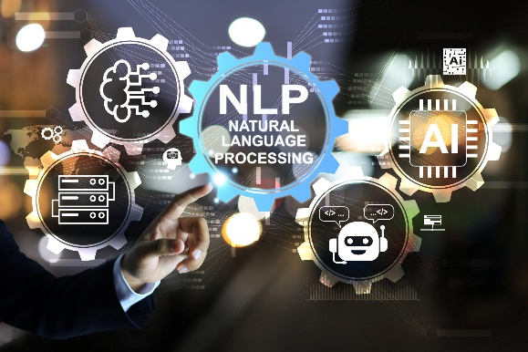

Dr. Muzamil Ahmed (Assistant Professor) Namal University Mianwali
Natural Language Processing
Text Preprocessing, Tokenization, Linguistic Basics

Slide 2

Lesson from Quran

Slide 3
Lecture Outline
Corpora
Regular Expressions

Slide 4
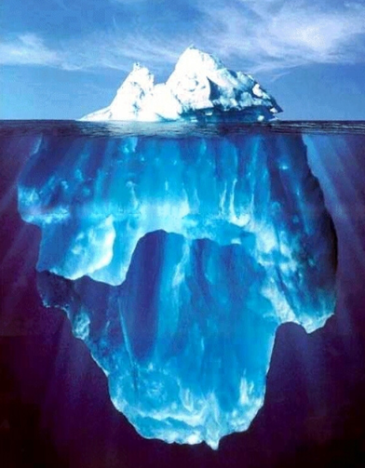
Text Data is Superficial
An iceberg is a large piece of freshwater ice that has broken off from a snow-formed glacier or ice shelf and is floating in open water.
… But Language is Complex

Slide 5
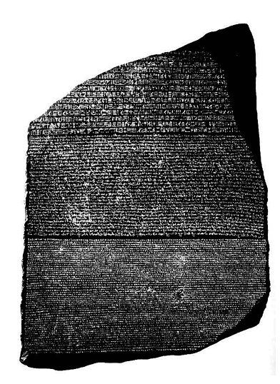
Corpora
A corpus is a collection of text
Often annotated in some way
Sometimes just lots of text
Balanced vs. uniform corpora
Examples
Newswire collections: 500M+ words (https://arxiv.org/abs/2406.09490)
Brown corpus: 1M words of tagged “balanced” text
The Web: billions of words of who knows what
NLTK Corpora : https://www.nltk.org/nltk_data/
Notes:
Balanced vs. Uniform Corpora
Balanced This refers to how the text is distributed across genres or sources.
A uniform corpus focuses on one specific domain or style.

Slide 6
Corpora
Words don't appear out of nowhere! A text is produced by
a specific writer(s),
at a specific time,
in a specific variety,
of a specific language,
for a specific function.
Notes:
When we analyze text in NLP, we often treat it as data — tokens, vectors, embeddings.
But linguistically:
Every word choice reflects intention.
Every structure reflects context.
Every variation reflects social and historical factors.

Slide 7
How many words in a corpus?
N = number of tokens
V = vocabulary = set of types, |V| is size of vocabulary
Heaps Law = Herdan's Law = |V |
= kN^{b}
where often .67 < β < .75
i.e., vocabulary size grows with > square root of the number of word tokens
 | Tokens = N | Types = |V|
Switchboard phone conversations | 2.4 million | 20 thousand
Shakespeare | 884,000 | 31 thousand
COCA | 440 million | 2 million
Google N-grams | 1 trillion | 13+ million

Slide 8
The Nature of Raw Text
Natural language data, as collected from web pages, books, transcripts, or social media, is not immediately usable by computational models.
What we call “text” is, at the machine level, simply a sequence of characters encoded in Unicode.
There is no inherent notion of words, sentences, or meaning — only symbols arranged in sequence.
Consider the string: Dr. Ali’s students aren’t coming at 9:00 a.m.!!!
A human reader immediately recognizes titles, possessives, contractions, time expressions, and sentence structure. A machine sees a linear character stream.
Text preprocessing is the process of transforming this raw character stream into structured linguistic units that computational models can operate on.
It is not mere cleaning — it is a controlled reduction of linguistic variability.

Slide 9
Why Preprocessing is Necessary in NLP
Statistical NLP models rely on estimating frequencies and probabilities over units such as words or subwords.
If surface variations are treated as distinct items, the vocabulary grows unnecessarily large, leading to sparse data problems.
For example:
Apple, apple, APPLE
If treated separately, each has fewer occurrences. If normalized, their counts merge, improving statistical reliability.
Thus, preprocessing serves three major goals:
Reduce sparsity
Standardize representation
Preserve meaning while reducing noise

Slide 10
Text Normalization as Canonicalization
Text normalization aims to map different surface forms that represent the same linguistic concept into a canonical representation.
For example:
“U.S.A.” and “USA”
“co-operate” and “cooperate”
“I’m” and “I am”
These variations arise from orthographic conventions, stylistic choices, or encoding differences.
Normalization reduces lexical diversity but may remove stylistic or syntactic signals. In information retrieval, aggressive normalization may help. In sentiment analysis or stylistic modeling, it may harm performance.
The central question is not “Should we normalize?” but rather “How much normalization is appropriate for this task?”

Slide 11
Case Folding and Its Consequences
Lowercasing is one of the simplest normalization steps. It merges tokens differing only in capitalization.
“Apple released a product.” “apple is a fruit.”
After lowercasing, both instances become “apple.”
While this reduces vocabulary size and increases frequency counts, it eliminates distinctions between named entities and common nouns.
In named entity recognition, capitalization is an important feature. In topic modeling, it may be irrelevant.
Thus, case folding is beneficial when lexical identity matters more than syntactic or entity information.

Slide 12
Unicode and Representation Consistency
Text collected from different sources may encode identical characters differently.
For example, accented characters can be stored as single composed characters or as base characters plus combining marks.
If these forms are not normalized, the model will treat visually identical words as different tokens. This creates artificial sparsity.
Unicode normalization ensures that equivalent characters are represented consistently. In multilingual NLP, this step is essential. Without it, cross-lingual modeling becomes unstable.
This stage is often invisible but critically important in real-world systems.

Slide 13
Unicode & Encoding Issues
Text may look identical but be encoded differently.
Example:
é may be:
• Single composed character • “e” + accent mark
If not normalized:
Models treat them as different tokens.
Unicode normalization ensures consistent representation across:
Operating systems
Web scraping
Multilingual corpora

Slide 14
Sentence Segmentation
The Problem of Sentence Boundaries
Humans easily recognize sentence boundaries. For machines, this is non-trivial.
A naive approach would split text at every period. However:
“Dr. Ahmed lives in the U.S. He teaches NLP.”
The period after “Dr.” and “U.S.” does not signal sentence termination.
Sentence segmentation must distinguish between:
• Abbreviations • Decimal numbers • Sentence-final punctuation
Modern systems treat sentence boundary detection as a classification problem using contextual cues rather than simple rules.

Slide 15
Linguistic Signals for Segmentation
Effective sentence segmentation relies on contextual features:
Is the word before the period a known abbreviation?
Does the next word begin with a capital letter?
Is the period part of a numeric pattern?
Does the punctuation sequence include exclamation or question marks?
In classical NLP systems, rule-based heuristics were used. In modern pipelines, segmentation is learned from annotated corpora.
The complexity of this task increases significantly in informal domains such as social media, where punctuation conventions are inconsistent.

Slide 16
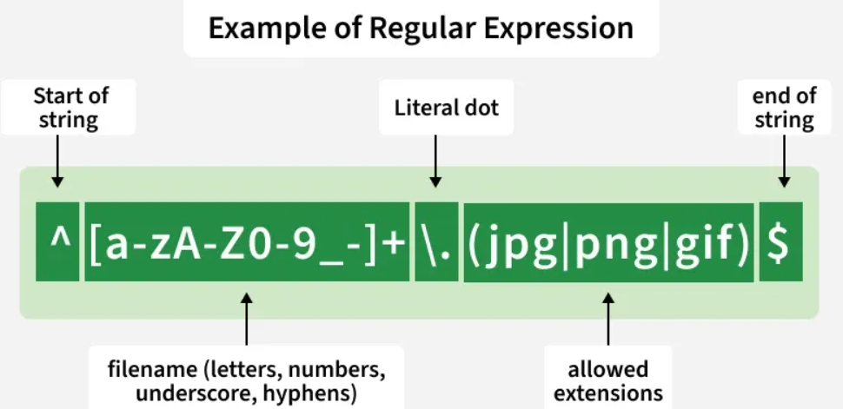
Regular Expressions
Regular expressions are used everywhere
Part of every text processing task
Not a general NLP solution (for that we use large NLP systems we will see in later lectures)
But very useful as part of those systems (e.g., for pre- processing or text formatting)
Necessary for data analysis of text data
A widely used tool in industry and academics

Slide 17

Regular expressions
A formal language for specifying text strings
How can we search for mentions of these cute animals in text?
woodchuck
woodchucks
Woodchuck
Woodchucks
Groundhog
groundhogs

Slide 18
Regular Expressions: Disjunctions
Letters inside square brackets []
Pattern | Matches
[wW]oodchuck | Woodchuck, woodchuck
[1234567890] | Any one digit
Ranges using the dash [A-Z]
Pattern | Matches
[A-Z] | An upper case letter | Drenched Blossoms
[a-z] | A lower case letter | my beans were impatient
[0-9] | A single digit | Chapter 1: Down the Rabbit Hole

Slide 19
Regular Expressions: Negation in Disjunction
Carat as first character in [] negates the list
Note: Carat means negation only when it's first in []
Special characters (., *, +, ?) lose their special meaning inside []
Pattern | Matches | Examples
[^A-Z] | Not an upper case letter | Oyfn pripetchik
[^Ss] | Neither ‘S’ nor ‘s’ | I have no exquisite reason”
[^.] | Not a period | Our resident Djinn
[e^] | Either e or ^ | Look up ^ now

Slide 20
Regular Expressions: Convenient aliases
Pattern | Expansion | Matches | Examples
\d | [0-9] | Any digit | Fahreneit 451
\D | [^0-9] | Any non-digit | Blue Moon
\w | [a-ZA-Z0-9_] | Any alphanumeric or _ | Daiyu
\W | [^\w] | Not alphanumeric or _ | Look!
\s | [ \r\t\n\f] | Whitespace (space, tab) | Look␣up
\S | [^\s] | Not whitespace | Look up

Slide 21
A note about Python regular expressions
Regex and Python both use backslash "\" for special characters. You must type extra backslashes!
"\\d+" to search for 1 or more digits
"\n" in Python means the "newline" character, not a "slash" followed by an "n". Need "\\n" for two characters.
Instead: use Python's raw string notation for regex:
r"[tT]he"
r"\d+" matches one or more digits
instead of "\\d+"

Slide 22
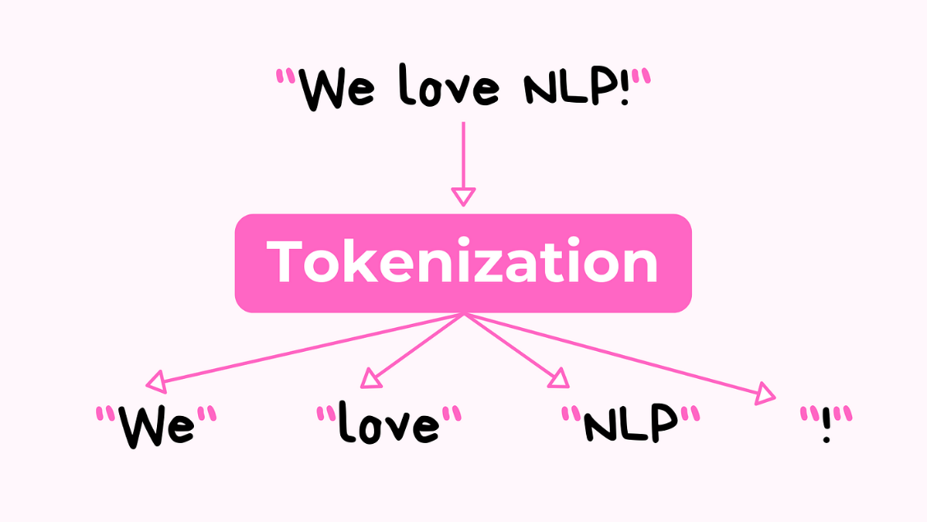
Tokenization
Tokenization defines the fundamental units that the model will operate on.
In English, whitespace appears to separate words. However, whitespace is not sufficient.
Consider:
“Don’t stop believing.”
Should “Don’t” remain one token, or be split into “Do” and “n’t”?
The decision affects syntactic analysis and language modeling.
Tokenization is therefore not trivial splitting. It encodes linguistic assumptions.

Slide 23
Tokenization Challenges in Real Text
Real-world text contains:
Contractions (don’t, I’m, they’ll)
Hyphenated compounds (state-of-the-art)
Multiword names (United Nations)
URLs and email addresses
Emojis and hashtags
Code-switching (“Yaar, this lecture was amazing!”)
Example:
“I love #NLP!!!”
Should “#NLP” be treated as a single semantic unit? In social media analytics, probably yes. In formal text analysis, perhaps not.
Thus, tokenization must align with the application domain.

Slide 24
Subword Tokenization in Modern NLP
Limitations of Word-Level Tokenization
Traditional NLP treated words as atomic units. However, this leads to two major problems:
Rare words are unseen during training.
Vocabulary size becomes extremely large.
For example: “electroencephalographically”
If unseen during training, it becomes an unknown token, losing internal structure information.
Notes:
EEG - Electroencephalographically means relating to the recording of the brain's spontaneous electrical activity (brain waves) using sensors (electrodes) placed on the scalp.

Slide 25
Subword Modeling
Modern language models developed by organizations such as Google and OpenAI address this problem using subword tokenization.
Instead of treating words as indivisible units, they are decomposed into frequently occurring subword components.
Example:
“playing” → “play” + “ing”
“unbelievable” → “un” + “believe” + “able”
This approach balances vocabulary size and expressive power.
It allows models to generalize to unseen words by leveraging shared subword structure.

Slide 26
Morphological Processing
Stemming: Heuristic Root Extraction
Stemming removes suffixes using hand-crafted rules. For example:
“running” → “run”
“studies” → “studi”
The goal is not linguistic perfection but reducing morphological variants to a shared base form.
The Porter Stemmer algorithm uses a sequence of condition-based suffix stripping rules. While efficient, it may produce stems that are not valid dictionary words.
Stemming is widely used in information retrieval systems where recall is more important than grammatical accuracy.
Notes:
The Porter Stemmer is one of the most famous stemming algorithms.
It works by:
Applying a sequence of rule-based suffix stripping steps
Checking conditions before removing endings
Progressively simplifying the word
Example rules:
Remove “ing” if certain conditions hold
Replace “ies” with “i”
Remove “ed” in specific contexts
It is:
Fast
Lightweight
Rule-based

Slide 27
Morphological Processing
Lemmatization: Linguistically Informed Normalization
Lemmatization uses vocabulary knowledge and part-of-speech information.
Example:
“better” → “good”
“running” (verb) → “run”
“running” (noun) → “running”
Unlike stemming, lemmatization preserves valid dictionary forms and respects grammatical categories.
It is computationally heavier but more semantically precise.

Slide 28
Function Words and Their Role
Stopwords are high-frequency grammatical words such as:
the, is, at, on, of
In bag-of-words models, they dominate frequency counts but contribute little topical meaning.
Removing stopwords reduces dimensionality and computational cost. However, in tasks such as sentiment analysis or question answering, these words may carry critical meaning.
For example:
“I do not like this.”
Removing “not” reverses sentiment.
Thus, stopword removal must be carefully considered.

Slide 29
Noise in Modern Text
Text from social media introduces additional complexity:
Repeated letters (“sooooo”)
Informal abbreviations (“gr8”)
Emojis
Hashtags
Normalization may compress repeated letters or map slang to canonical forms. However, aggressive normalization may remove stylistic signals important for sentiment detection.
Modern deep learning models are often trained on noisy corpora and may require minimal normalization compared to classical NLP pipelines.

Slide 30
Core Principles of Text Preprocessing
Text preprocessing is not mechanical cleaning. It is a series of linguistically informed design decisions that shape how language is represented computationally.
Every step — normalization, segmentation, tokenization, morphological reduction — alters the statistical structure of the corpus.
The guiding principle is:
Preprocessing should reduce harmful variability while preserving meaningful distinctions.
There is no universal preprocessing pipeline. The correct design depends on:
The task
The model
The data domain

Slide 31

Thanks

